Slide 1
Analog & Digital Data

Slide 2
Analog Data

Slide 3
Analog Data:
Smooth and continuous signals that represent a quantity, like sound waves.

Slide 4
Digital Data
A numerical representation of an analog signal, represented in increments.

Slide 5
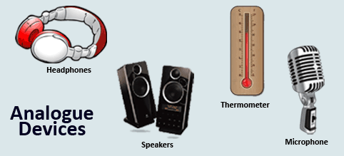
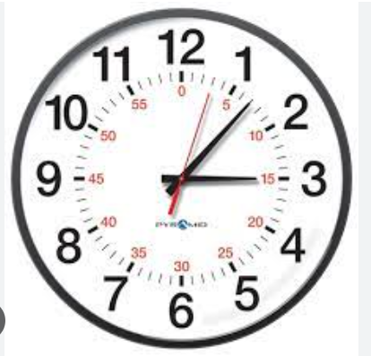
Analog devices:

Slide 6
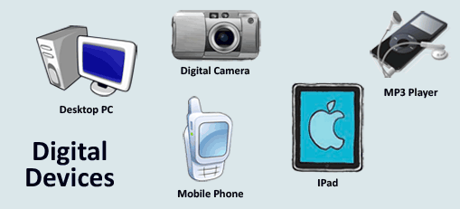
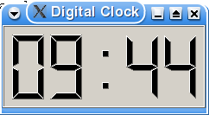
Digital devices:

Slide 7
Analog to Digital Conversion
What if you want a computer to measure something, like temperature or reflective light?
A digital computer can’t handle an infinite number of temperatures or light levels.
So it converts analog measurements to just a few digits.
Fortunately the digital approximation of analog measurements is perfectly fine for many applications.

Slide 8
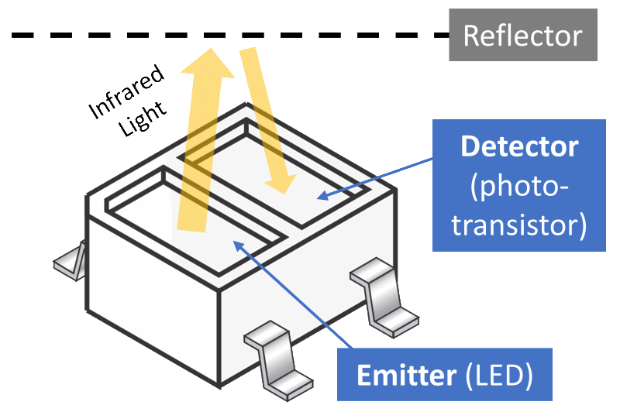
Analog to Digital Conversion
For example:
CodeBot’s line sensors emit IR light and then read the reflective light (analog). It converts the data to an integer between 0 and 4,095 (digital), since the analog-to-digital converter has 12 bits resolution.

Slide 9
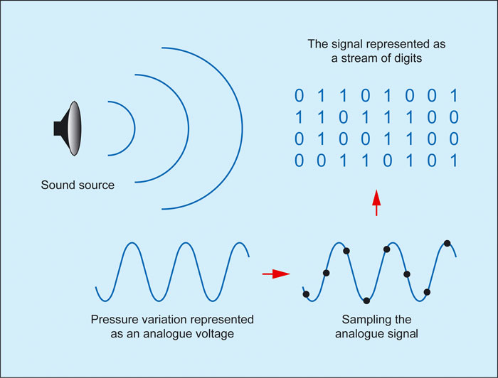
Example: Converting Analog to Digital
Source: https://www.soundonsound.com/techniques/digital-myth

